Slide 1




Urvi Pasad
Term 3: Machine Learning Foundation
Batch : October 19 Cohort

Slide 2
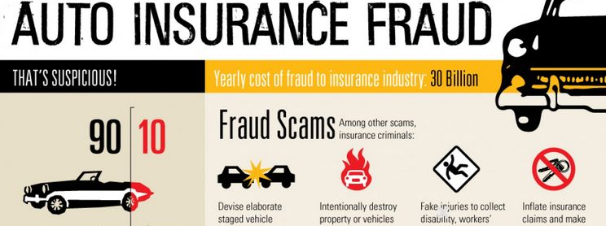
Problem Statement

Slide 3
GOAL
Our goal of this Case study is to identify the transaction which are fraud. If our algorithm predicts a transaction as non fraudulent but actually the transaction is fraudulent then it is big loss for the Auto insurance company hence the goal of this ML modeling is to minimize the False Negative. Hence the Recall should be close to One.

Slide 4

Data Description
Data is collected from below site. https://www.kaggle.com/buntyshah/auto-insurance-claims-data
There are 1000 rows and 40 columns
17 columns are of type Integer, 2 columns are of float type and 21 are Object column

Slide 5
Data Preprocessing
1
Remove columns with NA
3
Covert Categorical to Dummy
4
Find Correlation and drop highly correlated columns
2
Treating columns with bad data
5
Feature extraction for Train and Test Data

Slide 6
Data Modeling
Logistic Regression
Decision Tree with GridSearchCV
Random Forest
Decision Tree
Random Forest with Randomized SearchCV

Slide 7
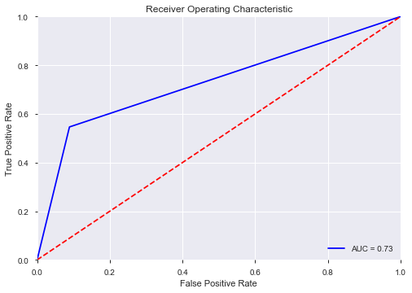
Logistic Regression
AUC_ROC Curve
Precision : 0.6941
Recall : 0.5462
F1_score : 0.6113

Slide 8
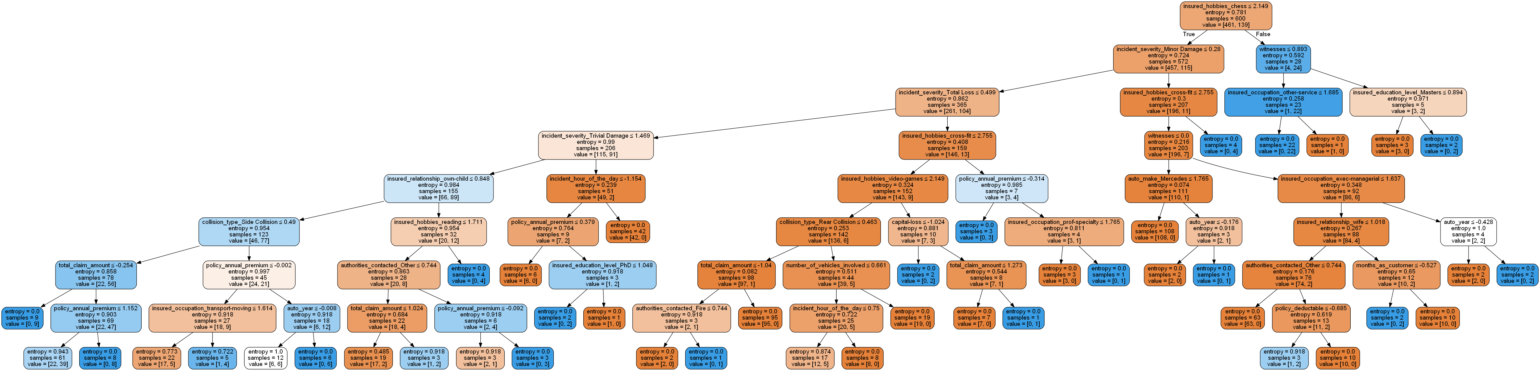
Decision Tree (criterion="entropy", max_depth = 8)
Precision : 0.6052
Recall : 0.6388
F1_score : 0.6216

Slide 9
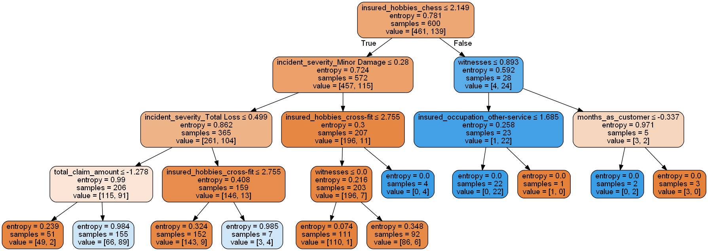
Decision Tree With GridSearchCV (criterion="entropy", max_depth = 4)
Precision : 0.6834
Recall : 0.8796
F1_score : 0.7692

Slide 10
Random Forest
Metric | Random Forest | Random Forest with Randomized search CV
Precision | 0.5588 | 0.6834
Recall | 0.1759 | 0.8796
F1_score | 0.2676 | 0.7692

Slide 11
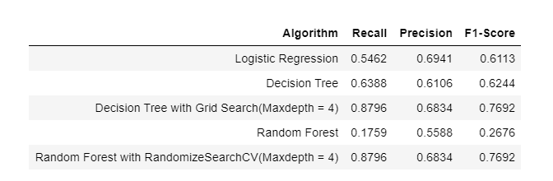
Model Evaluation Report

Slide 12
Conclusion
Best algorithm to minimize the False Negative(Recall close to 1)
Decision Tree with Maxdepth = 4 OR Random Forest with best Param
{'bootstrap': False, 'criterion': 'gini','max_depth': 4, 'max_features': None, 'min_samples_leaf': 1, 'min_samples_split': 3, 'n_estimators': 400}

Slide 13
Thank You

